Slide 1
Mainz
2019.01.01 from 01:00 to 23:59

Slide 2
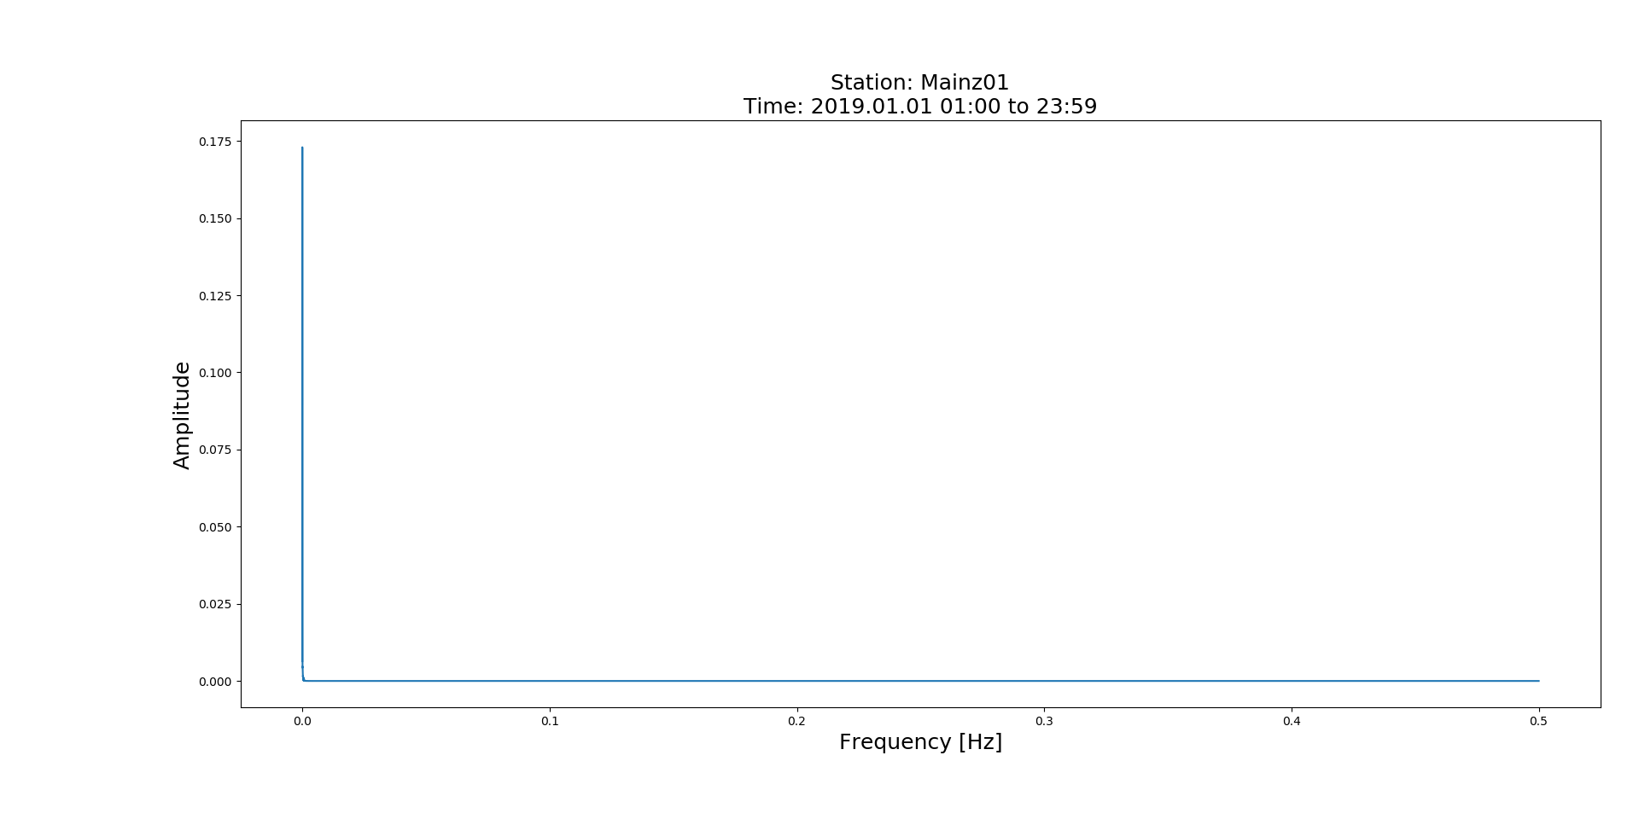
No Zoom-in Version

Slide 3
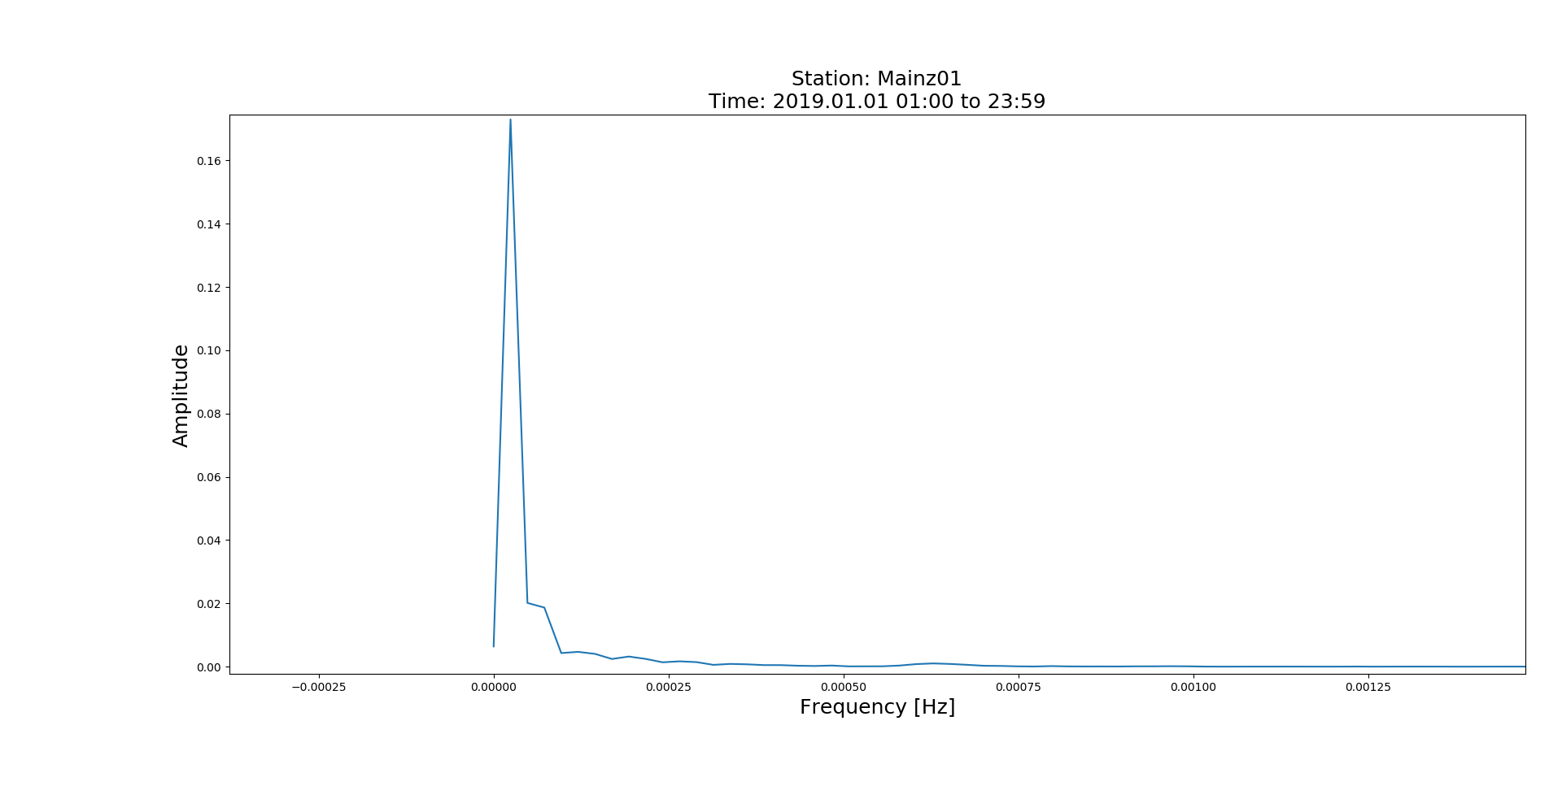
Period=745.60[min]
Zoom-in Version
Period=230.37[min]

Slide 4
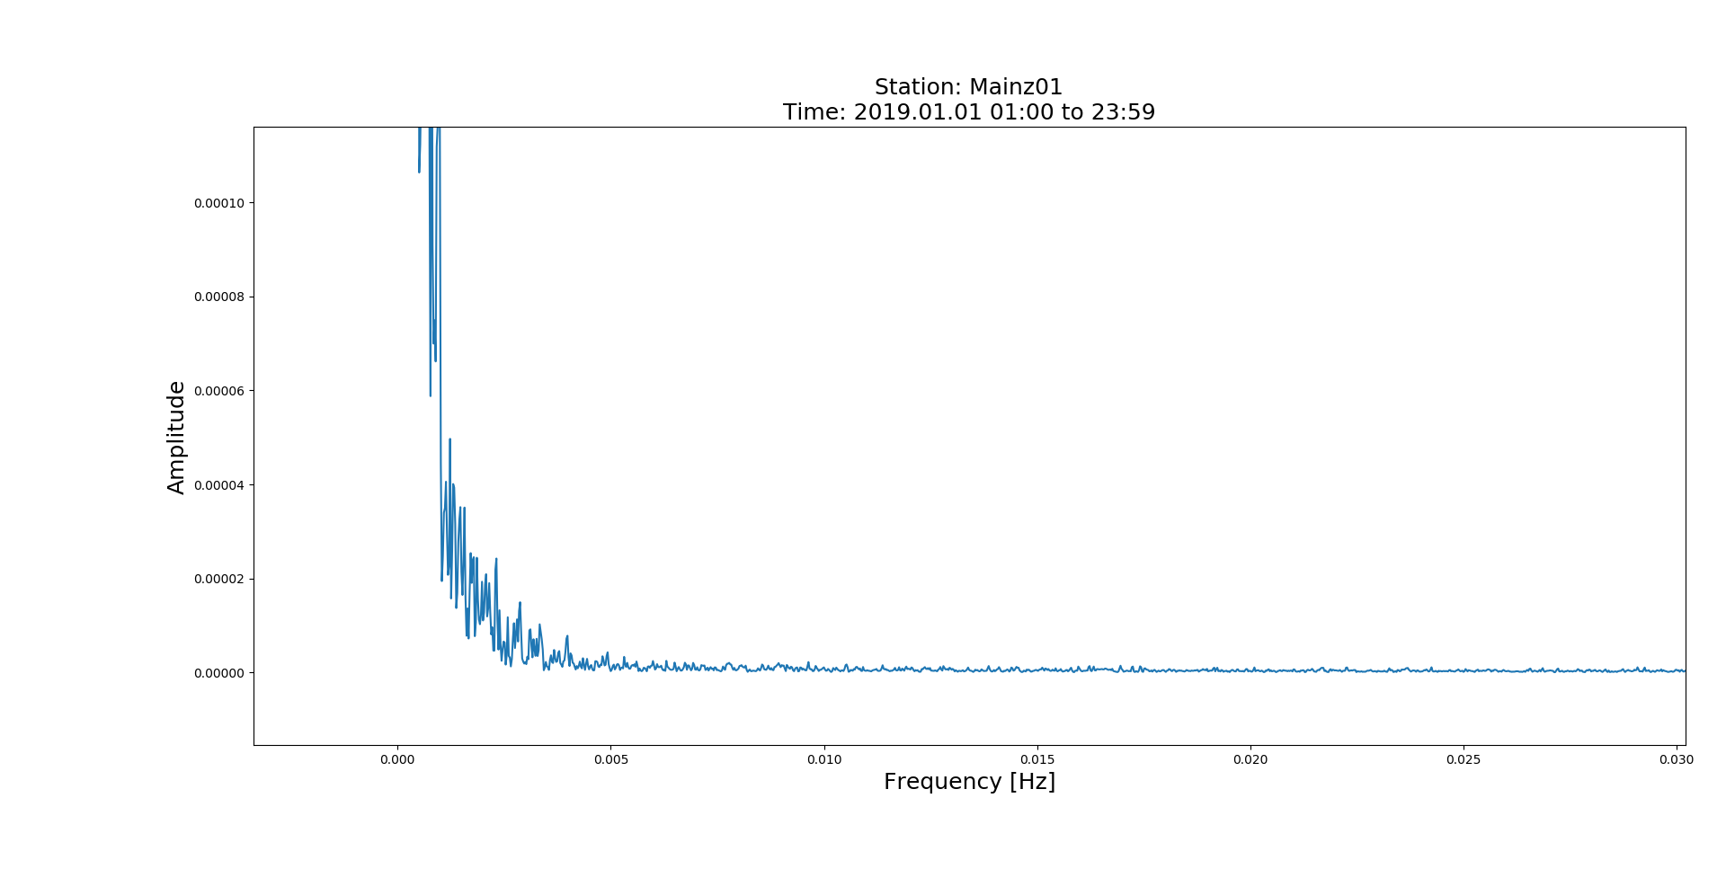
Zoom-in Version

Slide 5
Mainz
2019.01.02 from 00:00 to 11:59

Slide 6
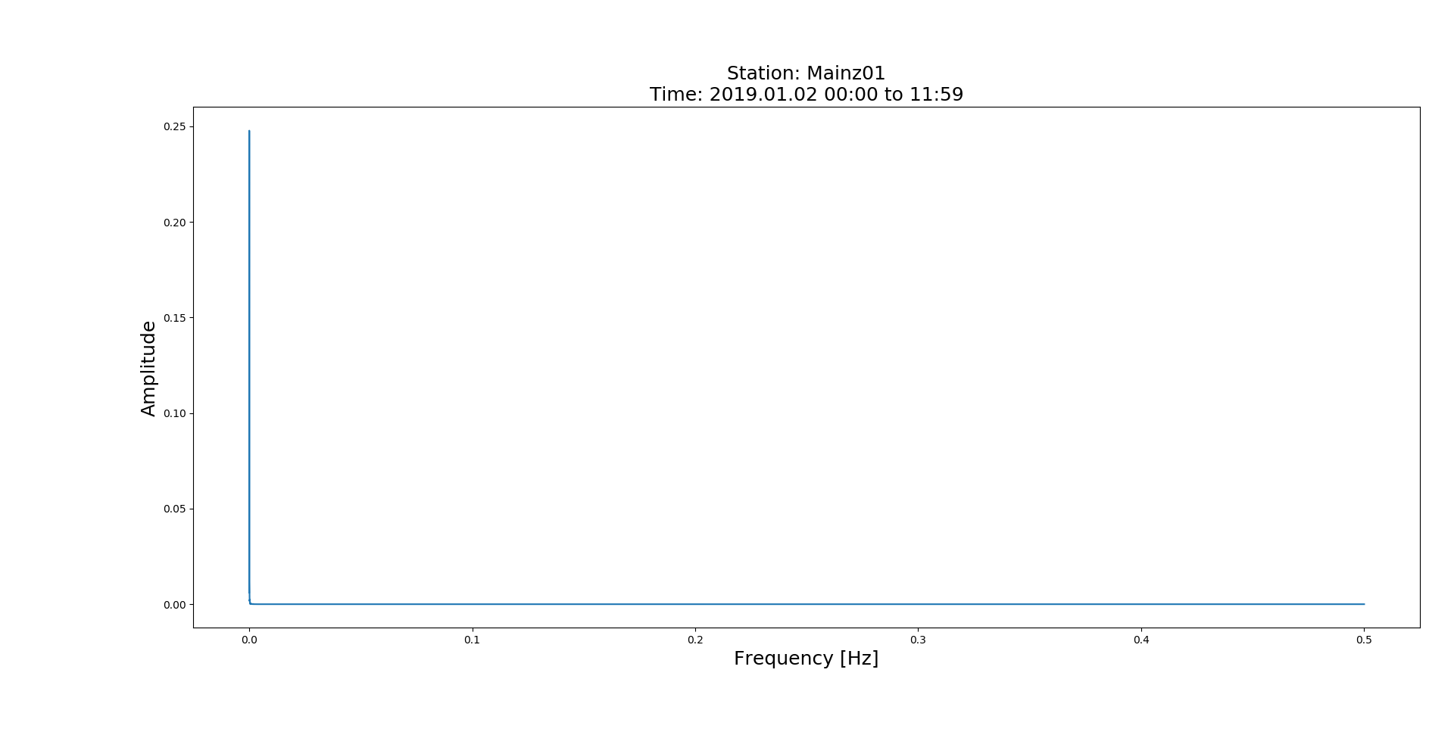
No Zoom-in Version

Slide 7
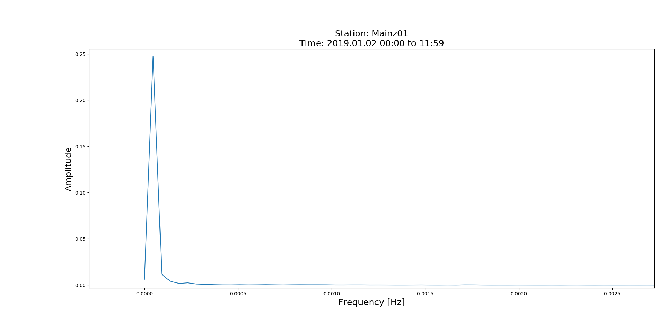
Period=369.83[min]
Zoom-in Version

Slide 8
Mainz
2019.01.01 from 01:00 to 23:59

Slide 9
No Zoom-in Version

Slide 10
Zoom-in Version

Slide 11
Hefei
2019.01.02 from 00:00 to 10:59

Slide 12
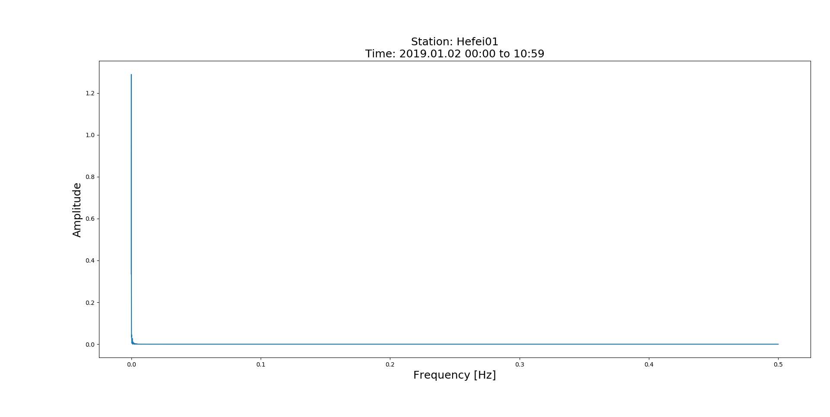
No Zoom-in Version

Slide 13
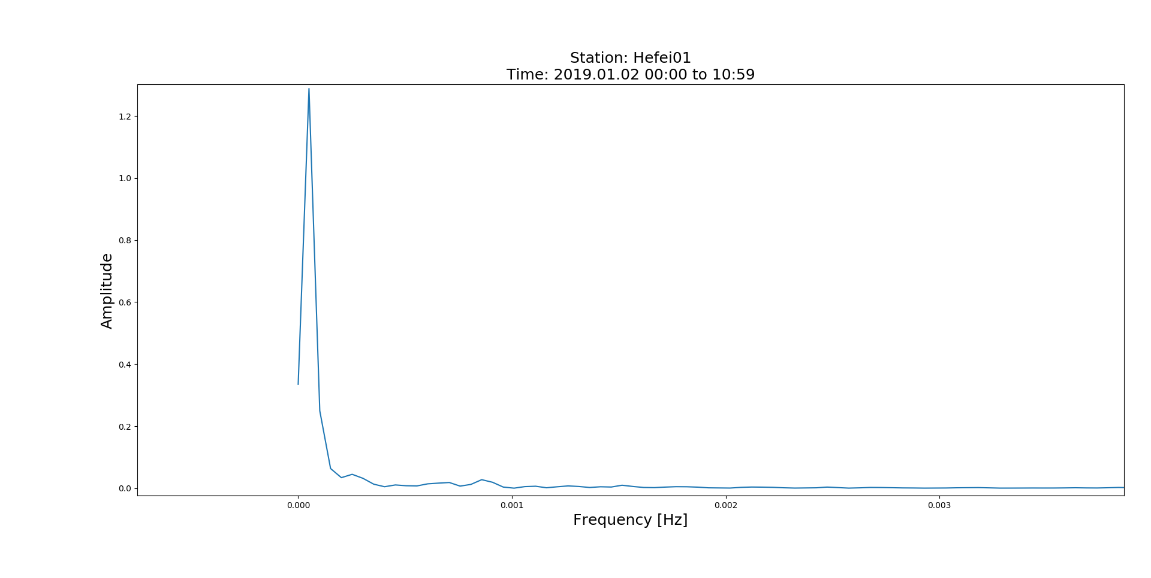
Period=358.32[min]
Zoom-in Version
Period=66.34[min]
Period=19.51[min]

Slide 14
Hefei
2019.01.02 from 12:00 to 23:59

Slide 15
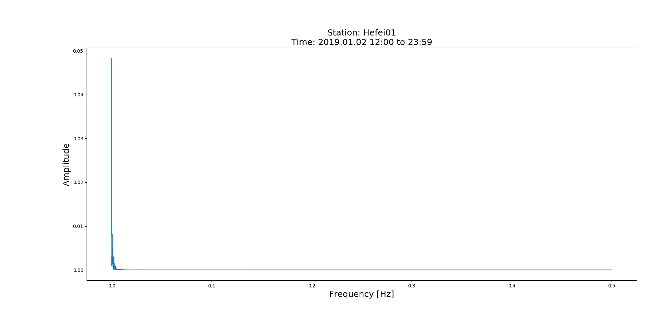
No Zoom-in Version

Slide 16
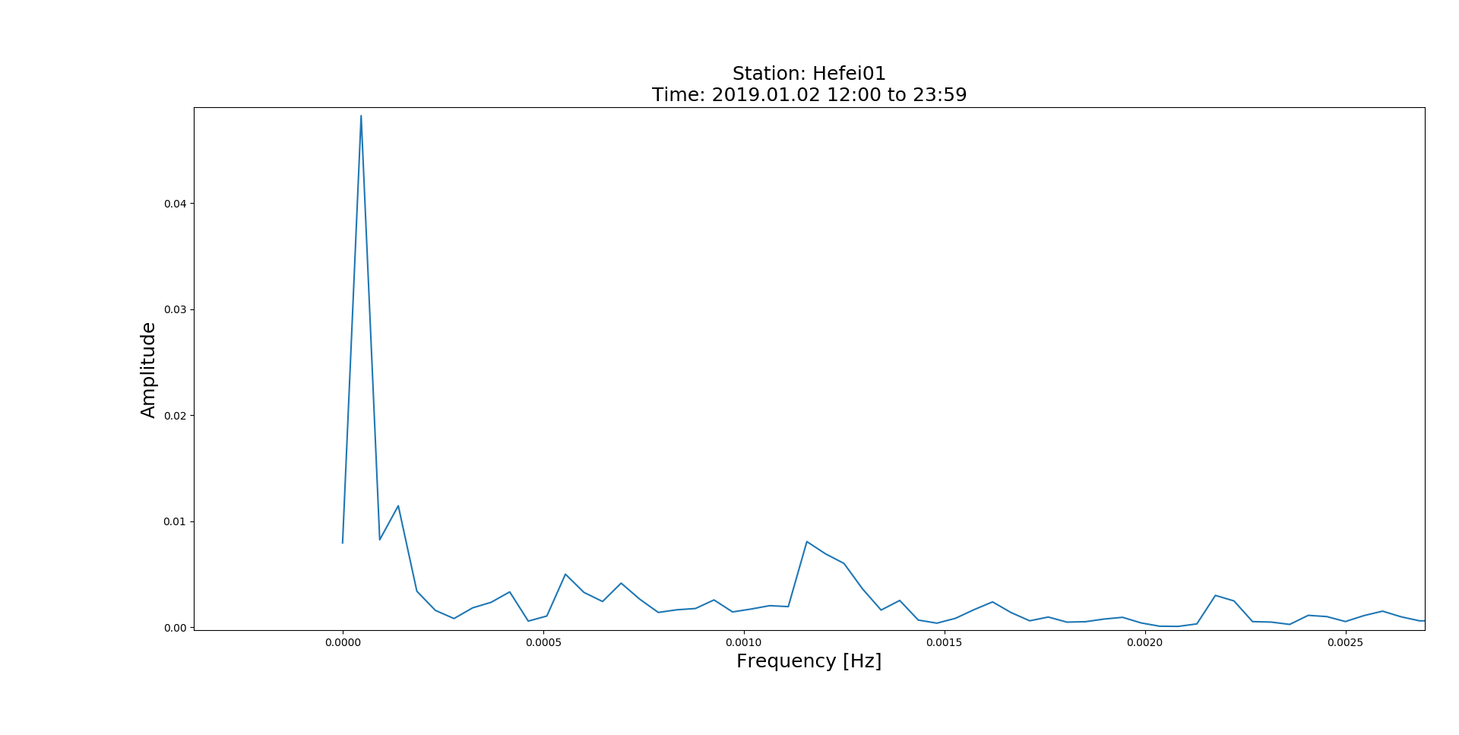
Period=349.43[min]
Zoom-in Version
Period=123.61[min]
Period=14.40[min]

